Slide 1
Forecasting Retail Store Sales Using Key Predictors
Thomas Jung

Slide 2
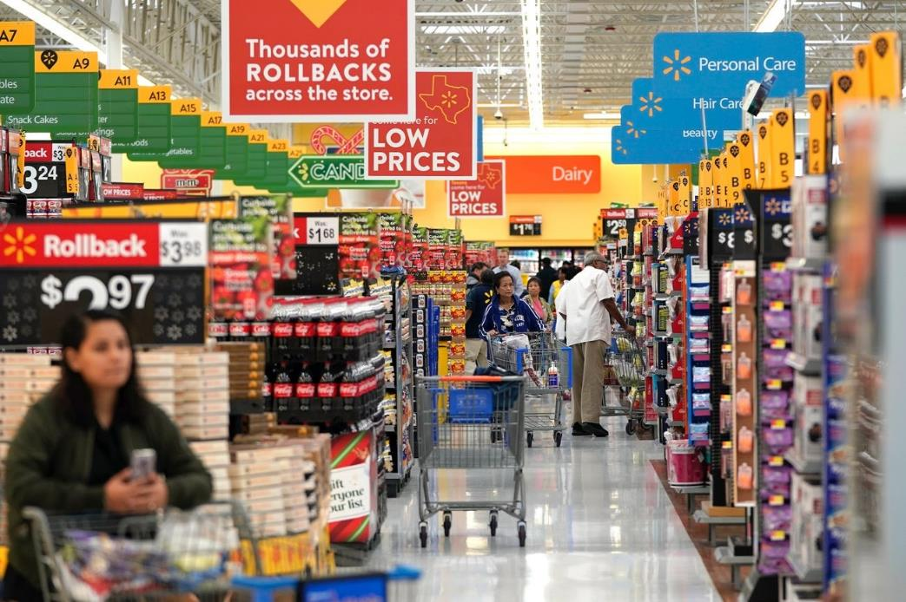

Introduction
Retail generates Big Data
Past:
Simple linear regressions
Humans choose factors
Present:
Complex machine learning algorithms
Machines choose most relevant factors

Slide 3

Objective
Predict retail sales volumes
Predictive factors?
Historical sales
Date, holidays
Weather
Fuel prices, unemployment rates
Machine learning algorithms
Multiple regression
XGBoost
Facebook Prophet

Slide 4
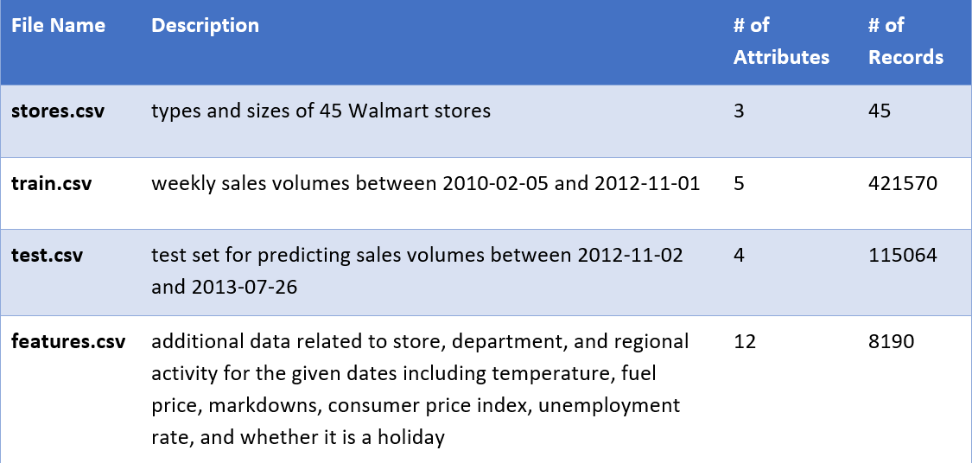
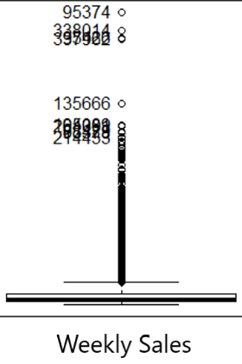
Dataset

Slide 5
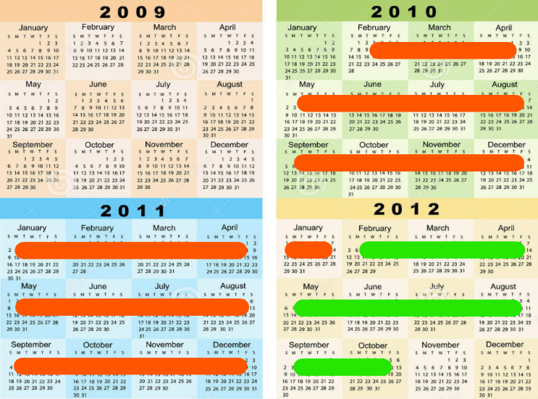
Dataset
Training set
Test set

Slide 6
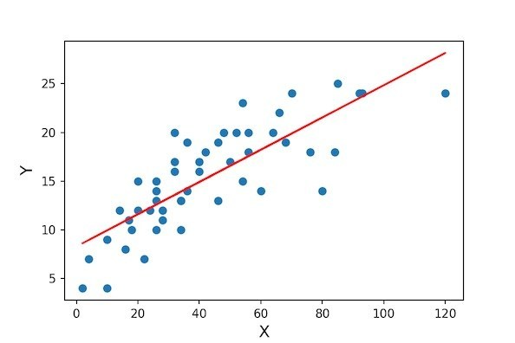
Multiple Regression
Fastest to implement
Parametric; most restrictive
Assumptions/requirements
linear relationships between DV & IVs
Residual errors must be normally distributed & homoscedastic
No multicollinearity

Slide 7
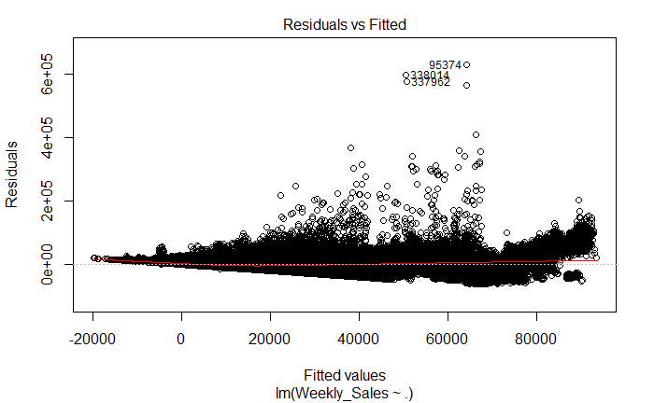
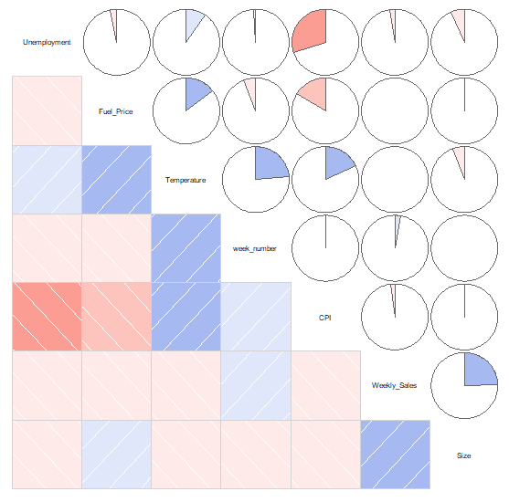
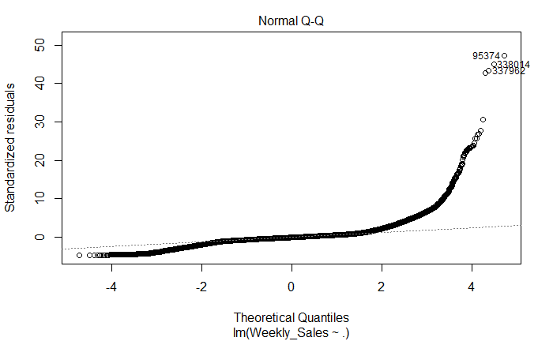
Multiple Regression

Slide 8
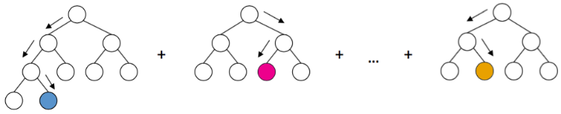
XGBoost
Ensemble learning algorithm
Less restrictive:
Non-parametric
Robust to outliers & missing values
Built-in cross validation & regularization
Required most time to implement

Slide 9

Prophet
Developed by Facebook
Time series predictions
Non-linear trends
Seasonality & holiday effects
Non-parametric
Ability to add predictive regressors

Slide 10
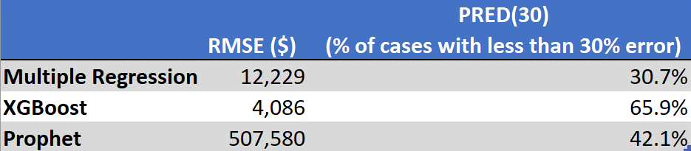
Results

Slide 11
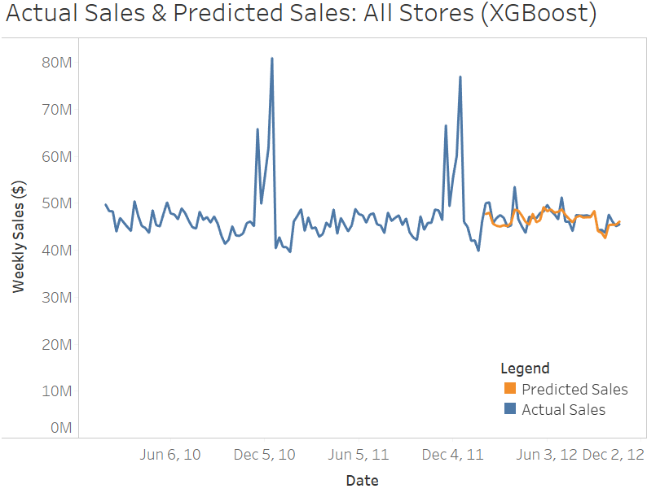
Results: XGBoost

Slide 12
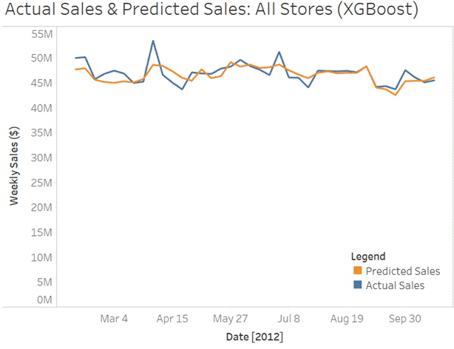
Results: XGBoost

Slide 13
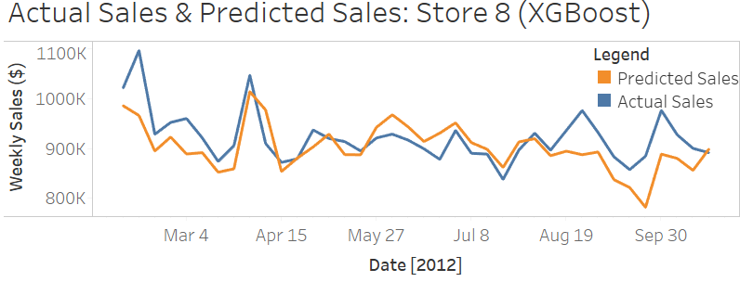
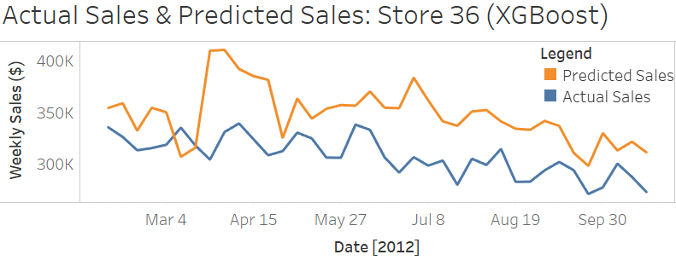
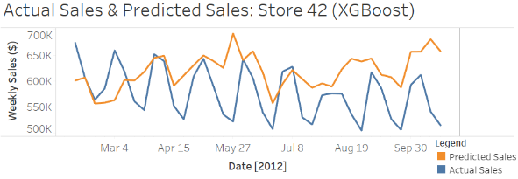
Results: XGBoost

Slide 14
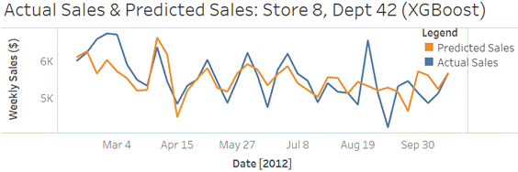
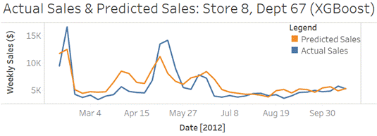
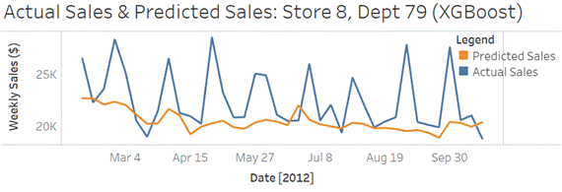
Results: XGBoost

Slide 15
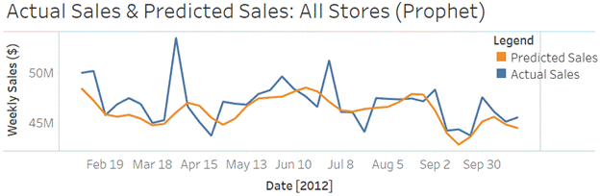
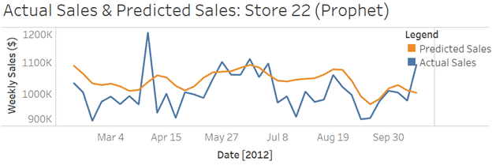
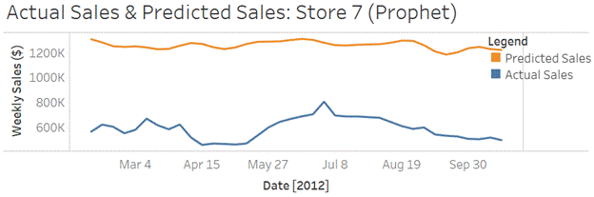
Results: Prophet

Slide 16
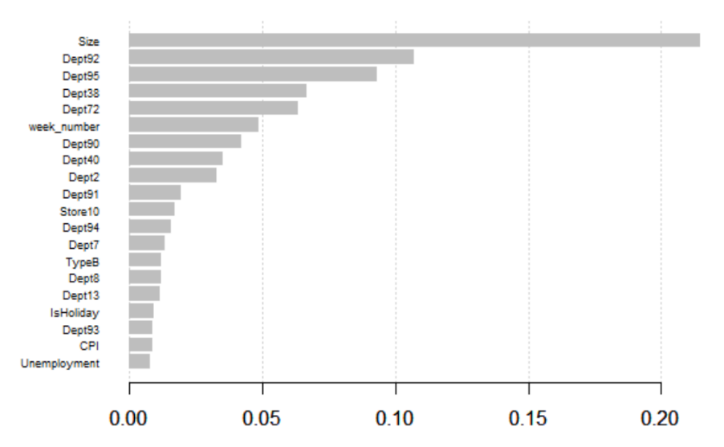
Importance Matrix (XGBoost)

Slide 17
Conclusion
XGBoost was the best algorithm for predictions
Enterprise-wide level:
65.9% of predictions had less than 30% error
Store-wide level:
Larger store predictions more accurate than smaller stores
Department-wide level:
Small- to medium-sized departments more accurate
Large spikes in sales
Captured most of the time in terms of date
Not fully captured in terms of magnitude
Notes:
XGBoost was the best algorithm for predicting weekly sales volumes despite taking the most time for modelling
predictions are fairly accurate at the enterprise-wide sales level, with 65.9% of the predicted cases being less than 30% different than the actual cases.
At the store level, XGBoost provided more accurate predictions for larger stores than for smaller stores
whereas at the department level, XGBoost performed the best on small- to medium-sized departments.
In all cases, large spikes in sales were captured most of the time in terms of the specific date, though not fully in terms of magnitude.

Slide 18
Conclusion
Hypothesis: weather, holidays, fuel prices, and unemployment rates can be used as predictors
Results: these factors play a minor role
Most predictive power
Size of the store
Store number
Department number
Week number
Notes:
Hypothesis: attributes such as weather, holidays, fuel prices, and unemployment rates can be used as predictors for sales volumes
Results of this investigation showed that these play a minor role.
size of the store, store number, department number, and week number provided the most predictive power.
having information on the specific store, department, and the point in time of the prediction is sufficient for generating accurate predictions.
This is shown by the fact that the Prophet algorithm generated a similar, fairly accurate prediction curve despite not being provided with any variable other than the dates, weekly sales, and the store number

Slide 19
Thank you. Questions?

